Slide 1
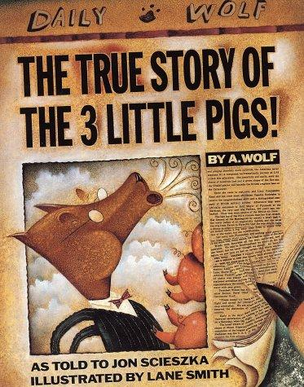
The True Story of the 3 Little Pigs!
As told to Jon Scieszka
Illustrated by: Lane Smith

Slide 2
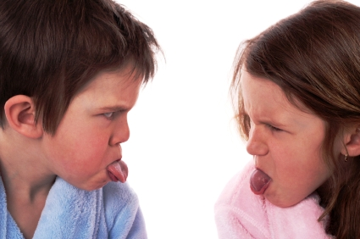
impolite
Not being nice
The boy and girl were being impolite by sticking out their tongues.

Slide 3
jazzed
Very excited
She was jazzed to open all her presents for her birthday.

Slide 4
framed
To make someone appear to be bad or have done something bad
They tried to frame the man for something he didn’t do.

Slide 5
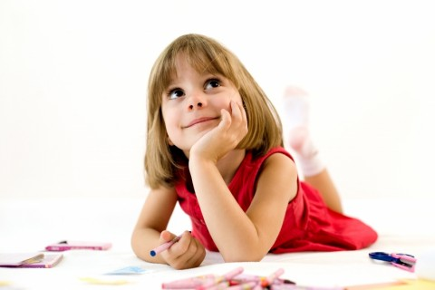
Which goes with impolite?

Slide 6
Which goes with jazzed?

Slide 7
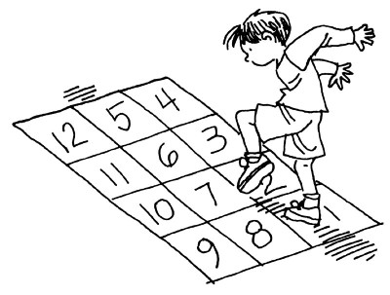
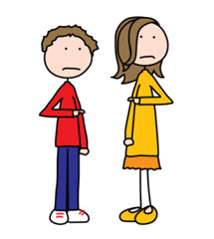
Which goes with framed?

Slide 8
Which word goes with this picture?
(impolite, jazzed, framed)

Slide 9
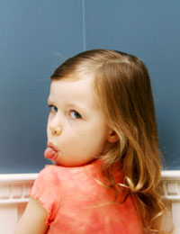
Which word goes with this picture?
(impolite, jazzed, framed)

Slide 10
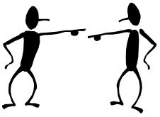
Which word goes with this picture? (impolite, jazzed, framed)

